Slide 1
Predicting Hotel Booking Cancellations with ML
CAPSTONE PROJECT
Presented By:
1. PR.Krithika Priya – Meenakshi Sundararajan Engineering College – Artificial Intelligence & Data Science

Slide 2
OUTLINE
Problem Statement (Should not include solution)
Proposed System/Solution
System Development Approach (Technology Used)
Algorithm & Deployment
Result
Conclusion
Future Scope
References

Slide 3
Problem Statement
Hotel managers face challenges in predicting and managing booking cancellations effectively. Leveraging historical data and machine learning, our solution aims to accurately forecast cancellations, optimize resource allocation, and enhance customer satisfaction. By incorporating external factors and deploying a user-friendly interface, hotels can improve operational efficiency and adapt to dynamic market conditions.

Slide 4
Proposed Solution
The proposed system aims to address the challenge of predicting hotel booking cancellations by leveraging data analytics and machine learning techniques. The solution will consist of the following components:
Data Collection:
Gather historical data on hotel bookings, including booking time, date, length of stay, demographics, special requests, and other relevant factors . Utilize external data sources, such as local events, holidays, and tourism trends, to enhance prediction accuracy.
Data Preprocessing:
Clean and preprocess the collected data to handle missing values, outliers, and inconsistencies .Perform feature engineering to extract relevant features from the data that might influence booking cancellation, such as lead time, booking channel, and previous cancellations.
Machine Learning Algorithm:
Utilize classification algorithms like Logistic Regression or Random Forest to predict hotel booking cancellations based on historical data patterns . Analyze various features like lead time, booking channel, and guest demographics to accurately forecast future booking cancellations
Deployment:
Create a user-friendly interface or application that provides real-time predictions for hotel booking cancellations . Incorporate machine learning models to analyze current cancellation trends and external factors like events or holidays . Ensure deployment on a scalable and reliable platform to handle varying user loads efficiently.
Evaluation:
Evaluate the model's performance using relevant metrics such as accuracy, precision, recall, and AUC score . Continuously monitor and fine-tune the model based on feedback to improve prediction accuracy over time.
Result:
The deployed system will empower hotel managers with actionable insights into booking cancellation patterns . By leveraging predictive analytics, hotels can optimize resource allocation, staffing levels, and revenue management strategies to minimize cancellations and enhance overall operational efficiency and customer satisfaction levels.

Slide 5
System Approach
System Requirements:
Operating System: Windows, macOS, or Linux
Processor: Any modern processor
RAM: At least 4 GB (8 GB recommended)
Storage: Free space for datasets and libraries
Libraries Required for Model Building:
Pandas: Data manipulation and analysis
Scikit-learn: Machine learning algorithms and model evaluation
Matplotlib: Data visualization
Seaborn: For statistical data visualization.
Google Cloud or IBM Cloud: For cloud-based deployment and scalability..
Jupyter Notebook (optional): For interactive data analysis and prototyping.

Slide 6
Algorithm & Deployment
Logistic Regression is chosen for predicting hotel cancellations due to its suitability for binary classification tasks and its interpretability:
Algorithm Selection:
For predicting hotel cancellations, we have chosen the Logistic Regression algorithm. Logistic Regression is a widely used classification algorithm suitable for binary outcomes, which aligns with our problem of predicting whether a hotel booking will be canceled or not.
Data Input:
Input features include lead time, stays in weekend nights, stays in week nights, number of adults, children, babies, and total special requests.
Training Process:
The algorithm is trained using historical data, with features as independent variables and cancellation status as the target variable. The model is fitted to the training data and evaluated for accuracy.
Prediction Process:
During prediction, real-time booking data is input into the trained model to predict whether a booking is likely to be canceled or not. Predictions are made based on learned relationships between features and cancellations.

Slide 7
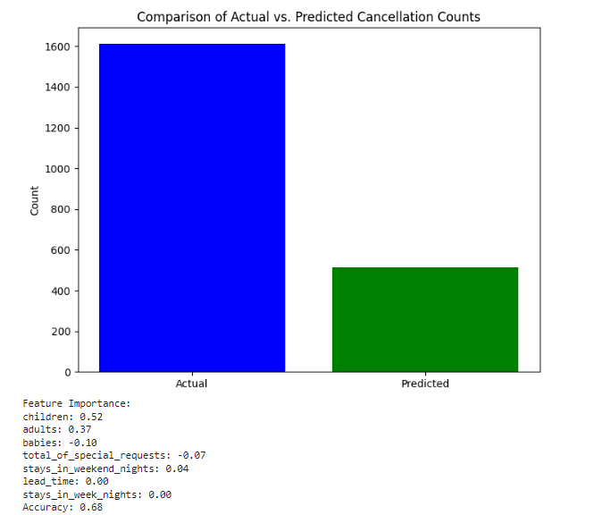
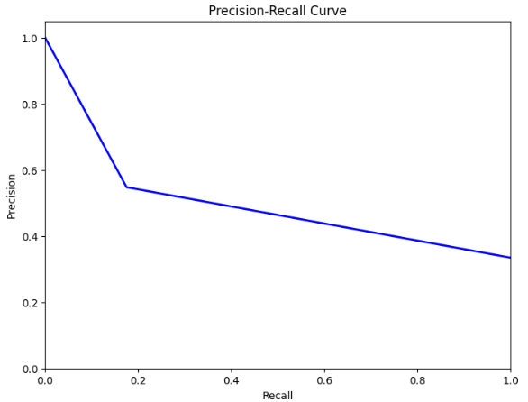
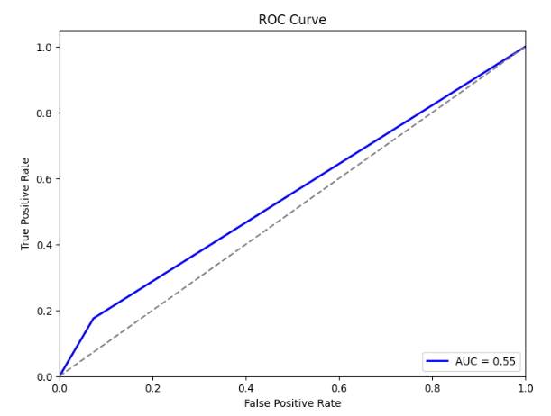
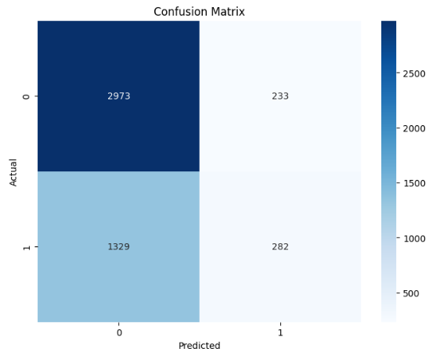
Result

Slide 8
Conclusion
Findings Summary:
Model Performance: Achieved 0.68
Confusion Matrix: Revealed 282 true positives and 1329 false negatives.
ROC Curve: Displayed AUC score as 0.55, signifying model's ability to discriminate between true positive rate and false positive rate.
Precision-Recall Curve: Illustrated 0.18 precision – recall balance.
Effectiveness of the Proposed Solution:
The proposed solution effectively predicts hotel booking cancellations, aiding in resource optimization and enhancing customer satisfaction.
Challenges Encountered:
Imbalanced Data: Posed challenges in model training and evaluation.
Feature Engineering: Required careful consideration and experimentation.
Model Interpretability: Understanding feature impacts was challenging.
Potential Improvements:
Advanced Modeling: Explore algorithms like Random Forests or Neural Networks.
Feature Engineering: Incorporate additional data sources for better predictions.
Imbalance Handling: Implement techniques like oversampling or under sampling.
Real-Time Prediction: Develop a system for continuous updates based on new data.
Importance of Accurate Prediction:
Accurate prediction is vital for resource optimization, revenue management, and sustainability efforts in urban areas

Slide 9
Future scope
Additional Data Sources:
Integrate weather data, economic indicators, and social media sentiment analysis for more comprehensive insights.
Algorithm Optimization:
Explore ensemble methods, hyperparameter tuning, and advanced feature engineering for improved prediction accuracy.
Expansion to Multiple Regions:
Scale the system to cover multiple cities or regions, considering regional variations and scalability.
Integration of Emerging Technologies:
Incorporate edge computing, deep learning, and natural language processing for enhanced real-time analysis and prediction.
Continuous Monitoring and Adaptation:
Implement a feedback loop for continuous model monitoring and refinement based on real-world performance.

Slide 10
References
https://ieeexplore.ieee.org/document/10128484
https://ieeexplore.ieee.org/document/8260781

Slide 11
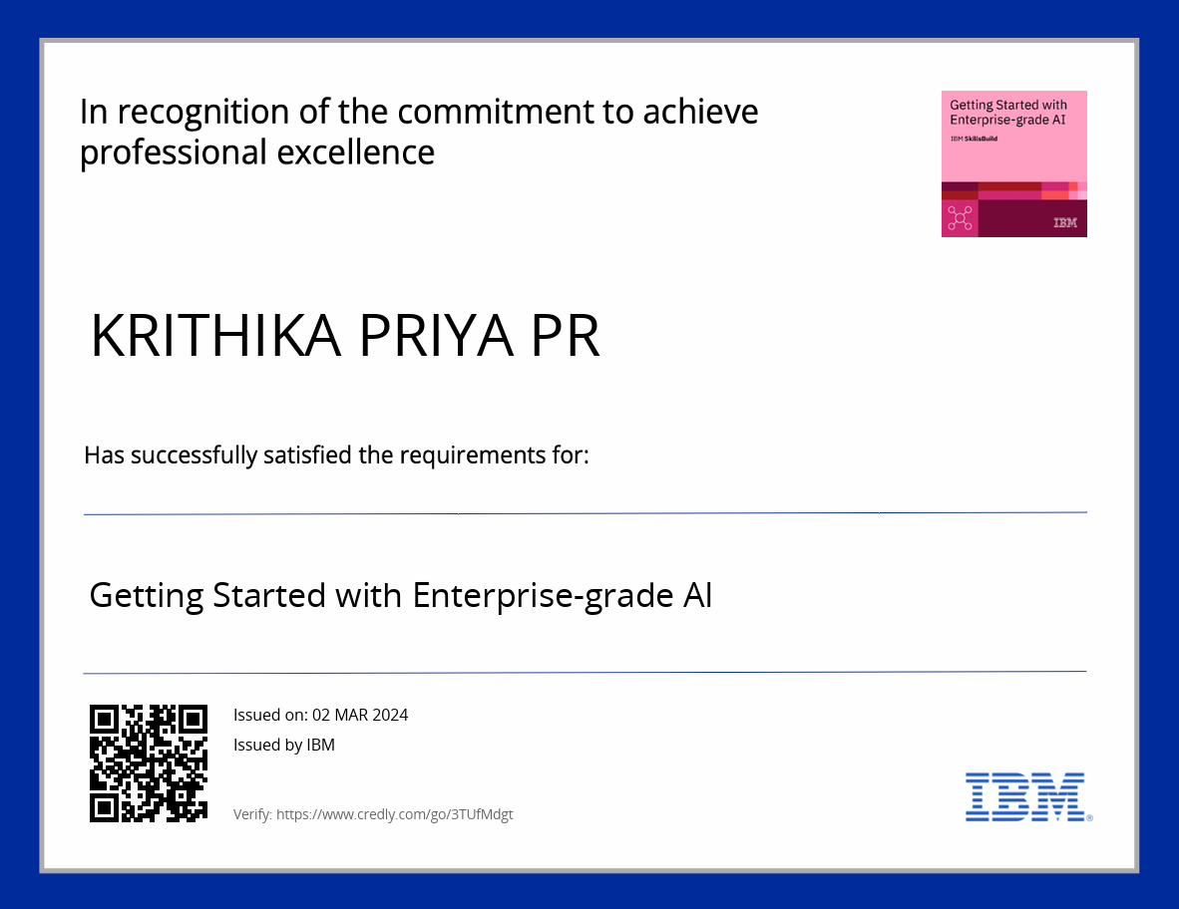
course certificate 1

Slide 12
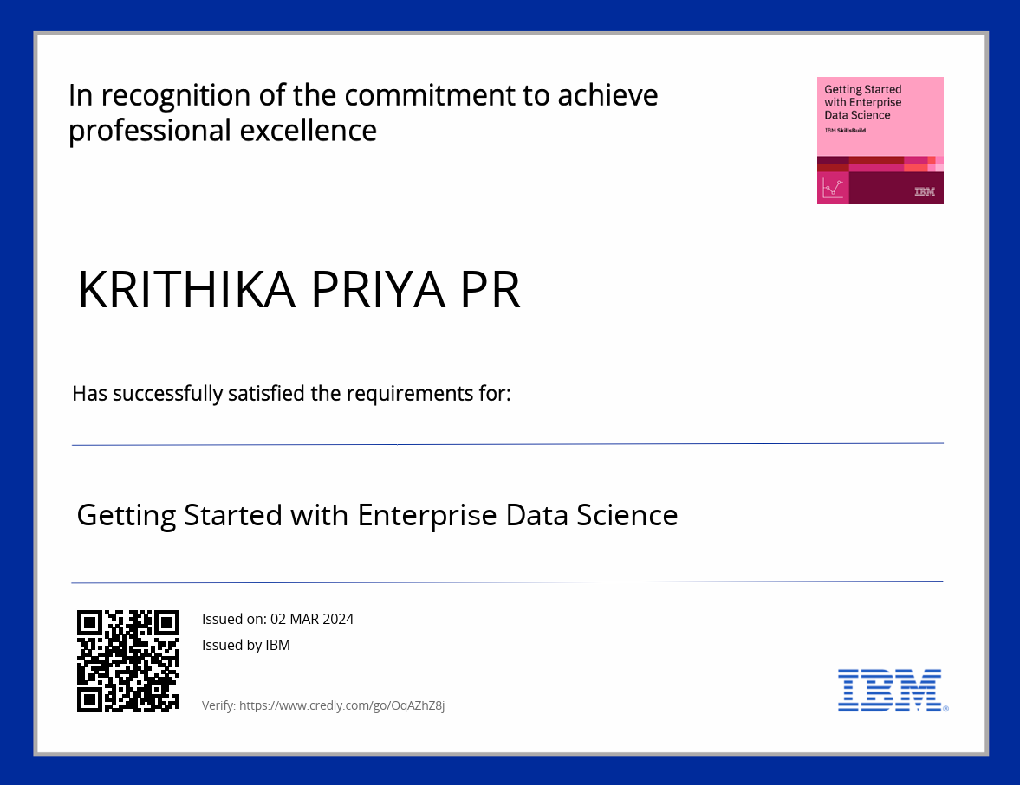
course certificate 2

Slide 13
THANK YOU

